Slide 1
CS 575
Design and Analysis of
Computer Algorithms
Professor Michal Cutler
Backtracking for optimization problems

Slide 2
This class
Main idea
A general algorithm
Backtracking for the 0/1 knapsack

Slide 3
Backtracking for optimization problems
To deal with optimization we compute:
  best - value of best solution achieved so far
  value(v) - the value of the solution at node v
  bound(v)
  Modify promising(v)

Slide 4
Backtracking for optimization problems
Best is initialized to a value that is
  equal to a candidate solution or
  worse than any possible solution.
Best is updated to value(v) if the solution at v is “better”
By “better” we mean:
  larger in the case of maximization and
  smaller in the case of minimization

Slide 5
Modifying promising
A node is promising when
  it is feasible and can lead to a feasible solution and
  “there is a chance that a better solution than best can be achieved by expanding it”
Otherwise it is nonpromising
To determine if a better solution can be achieved we compute a bound

Slide 6
Modifying Promising
A bound on the best solution that can be achieved by expanding the node must be computed and compared to best
If the bound > best for maximization, (< best for minimization) the node is promising
The challenge is to design an algorithm for computing a bound that is:
  Fast
  Prunes many nodes

Slide 7
The Bound for
Maximization Problems
For a maximization problem the bound is an upper bound,
  the largest possible solution that can be achieved by expanding the node must be less or equal to the upper bound
If upper bound > best a better solution may be found by expanding the node and the feasible node is promising

Slide 8
The Bound for
Minimization Problems
For minimization the bound is a lower bound,
  the smallest possible solution that can be achieved by expanding the node must be less or equal to the lower bound
If lower bound < best a better solution may be found and the feasible node is promising

Slide 9
Template for backtracking for optimization problems.
best is the best value so far and is initialized to a value that is equal or worse than any possible solution.
value(v) is the value of the solution at the node.
Procedure checknode (node v ) {
node u ;
if ( value(v) is better than best )
best = value(v);
if (promising (v) )
for (each child u of v)
checknode (u );
}

Slide 10
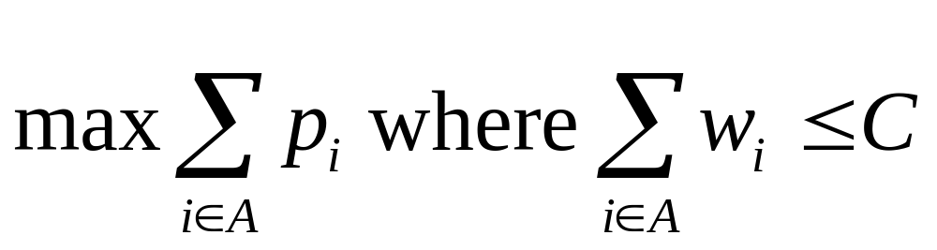
0/1 Knapsack problem
Given a knapsack with integer capacity C > 0.
A set S of n items with integer weights w_{i} >0 and profits p_{i}> 0 for i = 1,…,n.
Determine a subset A of { 1, 2, …, n } that satisfies the following:

Slide 11
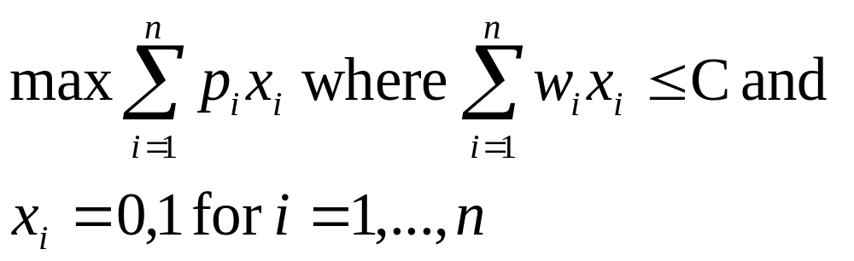
0/1 Knapsack problem
Let x[1],…,x[n] be n solution variables. The problem is to determine x that satisfies:

Slide 12
Knapsack with Fractions (KWF)
In this problem a fraction of any item may be chosen
There is a greedy algorithm for this problem
The following greedy algorithm uses the maximum profit per unit of weight selection criteria:
  Sort items in decreasing (nonincreasing) p_{i} / w_{i}.
  Fill the knapsack in the sorted order

Slide 13
The binary state space tree for 0/1 knapsack
Each node v includes 3 values:
  profit (v) = sum of profits of all items included in the knapsack (on a path from root to v)
  weight (v)= the sum of the weights of all items included in the knapsack (on a path from root to v)
  upperBound(v). upperBound(v) is greater or equal to the maximum benefit that can be found by expanding the whole subtree of the state space tree with root v.
The nodes are numbered in the order of expansion

Slide 14
Notation
We use maxprofit to denote best
profit(v) to denote value(v)
maxprofit is initialized to $0, which is the worst profit that can be achieved with positive p_{i}s
Before determining if node v is promising, maxprofit is updated to max{maxfrofit, profit(v)} and bestset is updated

Slide 15
Promising nodes for 0/1 knapsack
Node v is promising if weight(v) ≤ C, and upperBound(v)>maxprofit
Otherwise it is not promising

Slide 16
Main idea for upper bound
Theorem: The optimal profit for integer 0/1 knapsack ≤ optimal profit for KWF
Proof:
Clearly the optimal solution to integer 0/1 knapsack is a possible solution to KWF. So the optimal profit of KWF is greater or equal to that of integer 0/1 knapsack
Main idea: KWF can be used for computing the upper bounds

Slide 17
Computing the upper bound for 0/1 knapsack
Given node v at depth i.
KWF requires that the items be ordered by non increasing p_{i} / w_{i},
So if we arrange the items in this order before applying the backtracking algorithm, KWF will pick the remaining items in the required order.

Slide 18
C++ version
The arrays w, p, include and bestset have size n+1.
Location 0 is not used
include contains the current solution
bestset the best solution so far

Slide 19
Before calling Knapsack
numbest=0; //number of items considered
maxprofit=0;
knapsack(0,0,0);
cout << maxprofit;
for (i=1; i<= numbest; i++)
  cout << bestset[i]; //the best solution
Note: The values in bestset are either “yes” or “no”

Slide 20
knapsack(i, profit, weight)
if ( weight <= C && profit > maxprofit)
// save better solution
maxprofit=profit //save new profit
numbest= i; bestset = include//save solution
if promising(i)
include [i + 1] = “ yes”
knapsack(i+1, profit+p[i+1], weight+ w[i+1])
include[i+1] = “no”
knapsack(i+1,profit,weight)
Copy for debugging

Slide 21
Promising(i)
  //Cannot get a solution by expanding node
  if weight >= C return false
  //Initialize
  j = i + 1; //next item
  bound = profit;
  totweight = weight;

Slide 22
Promising(i) cont.
  //Compute upper bound
while( j ≤ n && totweight + w[j]<= C) {
totweight = totweight + w[j];
bound = bound + w[j];
j++; }
if (j ≤ n) //fill knapsack
bound = bound + (C – totweight)*p[j]/w[j]
return bound > maxprofit;

Slide 23
Example from Neapolitan & Naimipour
Suppose n = 4, C = 16, and we have the following:
i p_{i} w_{i} p_{i} / w_{i}
1 $40 2 $20
2 $30 5 $6
3 $50 10 $5
4 $10 5 $2
Note the the items are in the correct order needed by KWF

Slide 24
profit
Example
weight
$0
0
$115
bound
F - not feasible
N - not optimal
B- cannot lead to best solution
maxprofit =0
1
2
$40
2
$115
Item 1 [$40, 2]
maxprofit =40
$0
0
$82
13
3
B
82<90
$70
7
$115
$40
2
$98
Item 2 [$30, 5]
maxprofit =70
8
maxprofit = 90
4
$120
17
$70
7
$80
$90
12
$98
$40
2
$50
5
9
12
Item 3 [$50, 10]
F
17>16
B
50<90
$80
12
$80
$70
7
$70
10
$90
12
$90
$100
17
Item 4 [$10, 5]
6
7
11
maxprofit =80
N
N
F
17>16
Optimal

Slide 25
What about the leaves?
When knapsack has either included or excluded the nth item, upperBound(v) = profit(v), and the node is a leaf node.
Since maxprofit is updated for every node, upperBound(v) = profit(v) ≤ maxprofit
So the node is not promising
Thus all the leaf nodes in the pruned space state tree are non promising

